Slide 1
Data Ingestion

Slide 2
Data Ingestion
Semantic Search
Chunk Data
Embeddings

Slide 3

Data Ingestion - Why
Challenges in Making Corporate AI Truly Intelligent
LLMs are trained offline on a massive corpus of internet data, books, and other information and are unaware of events after training
LLMs do not know your business’s proprietary information

Slide 4

Beyond Generalized Models
LLM Pretrained Data
Specific information about your company, your products, your procedures

Slide 5
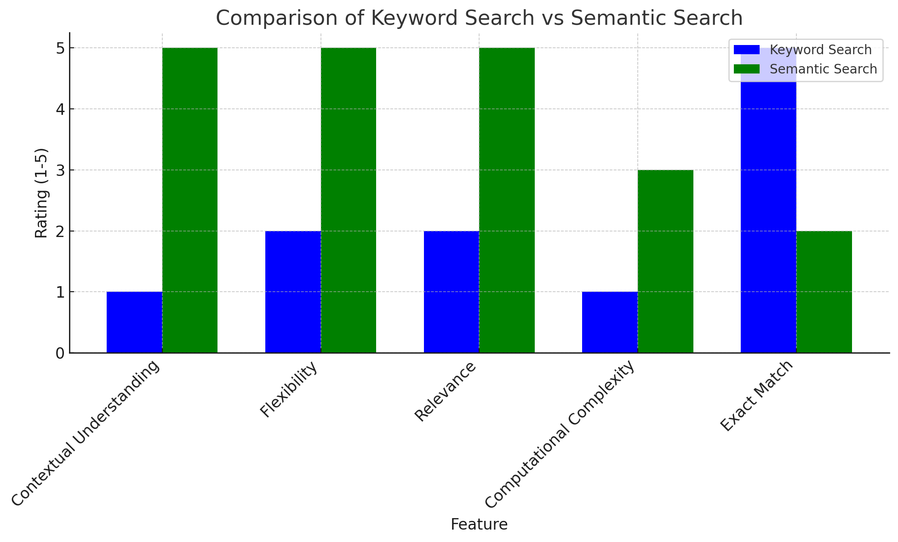
Keyword vs Semantic Search
Keyword search is efficient but rigid and lacks contextual understanding, making it more suitable for precise, exact-word queries.
Semantic search is flexible and understands context, providing more relevant and user-friendly results, but it requires more resources and is computationally more intensive.
Incorporating semantic search into corporate chatbots or search engines can make it easier for users to find information based on intent and meaning rather than being restricted to exact keywords

Slide 6
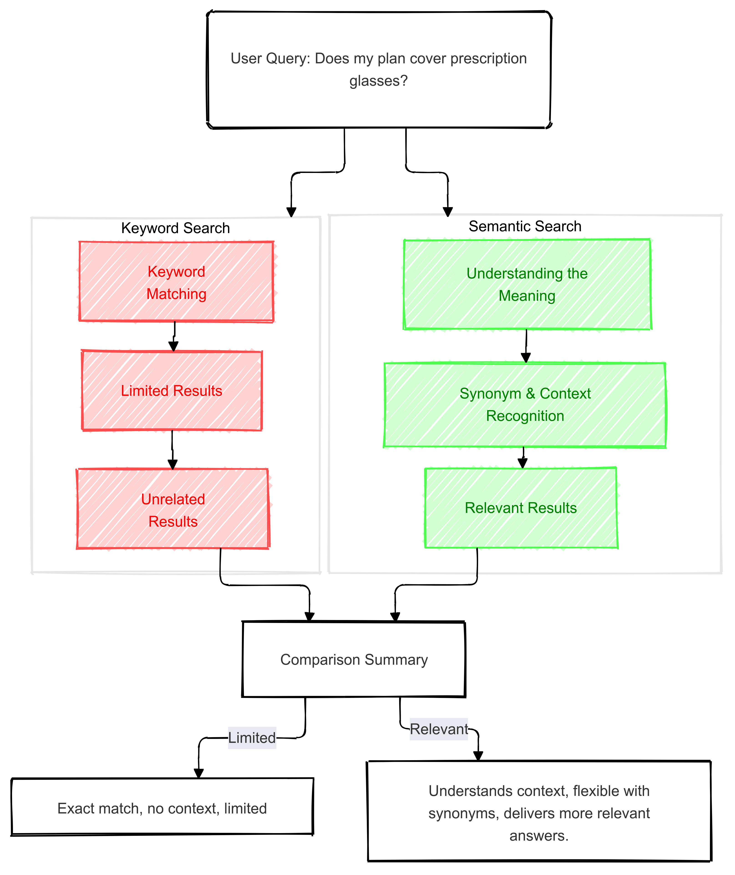
Keyword vs Semantic Search
Lacks context: Look for exact matches: “plan”, “cover”, “prescription glasses”
Understands context: user is asking about “insurance coverage”
Lacks Synonym match: Corrective lenses vs prescription glasses
Understands Synonyms: Maps prescription glasses to corrective lenses
Lacks Relationship Recognition: map in unrelated information because it mentions “plan”.
Understands Relationships: prioritized search results that explain insurance coverage for vision-related benefits
Lacks Language Variation: “Are prescription glasses included in my health plan?”
Understands Language Variation: “Are prescription glasses included in my health plan?” – question is semantically the same
Lacks Inference / Assumption: May fail to return meaningful results if the question is asked differently
Understands Inference / Assumption: Can infer that user is asking about insurance coverage for a specific service

Slide 7
Embeddings
Capturing Context and Meaning: Embeddings transform words, phrases, or documents into dense vectors in a high-dimensional space, allowing the model to capture the meaning and context of text rather than just matching keywords.
Synonym Recognition: Since embeddings place semantically similar words (like "prescription glasses" and "corrective lenses") close to each other in vector space, semantic search can return relevant results even when different words are used.
Handling Variations in Language: Embeddings allow the model to understand variations in phrasing and sentence structure, making it easier to recognize the same query intent expressed in different ways.
Improved Relevance Scoring: By comparing the distances between query and document embeddings, semantic search ranks results based on conceptual similarity, ensuring more relevant documents are surfaced.
Contextual Matching Beyond Exact Terms: Embeddings enable the search to return results that match the meaning of a query, not just the literal words, making it more useful for complex or natural language queries.

Slide 8
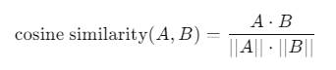
Embeddings
Cosine Similarity (most common)
Measure angle between two vectors
"cat" = [0.12, -0.45, 0.33, 0.98, -0.27, ..., 0.05]
"feline" = [0.11, -0.46, 0.31, 0.97, -0.25, ..., 0.04]
Euclidean Distance
Measures the straight-line distance between two vectors
"car" = [0.89, -0.67, -0.23, 0.04, 0.76, ..., -0.15]

Slide 9
Chunking Data
Window & Stride
Original document
Mary had a little lamb. Its fleece was white as snow
Chunked document with 50% Stride
Chunk 1: "Mary had a little“
Chunk 2: "a little lamb. Its“
Chunk 3: "lamb. Its fleece was"

Slide 10
Chunking Data
Window & Stride how it helps sematic searching
Captures Broader Context: Chunking with windows ensures the model understands surrounding context, improving semantic search accuracy.
Preserves Critical Information: Using overlapping strides prevents losing important data at chunk boundaries.
Optimizes Embedding Creation: Smaller, well-chunked sections enable more accurate and relevant semantic search results.
Handles Long Documents Efficiently: Breaks large texts into manageable pieces, fitting within model limits while preserving meaning.
Improves Performance: Reduces memory usage and processing overhead by working with smaller portions of text.

Slide 11

LangChain Framework for Data Ingestion
LangChain Document Loaders
LangChain Vectorstores
These classes load Document objects. LangChain has hundreds of integrations with various data sources to load data from: Slack, Notion, Google Drive, etc.
One of the most common ways to store and search over unstructured data is to embed it and store the resulting embedding vectors, and then at query time to embed the unstructured query and retrieve the embedding vectors that are 'most similar' to the embedded query. A vector store takes care of storing embedded data and performing vector search for you.
LangChain Embedding Models
Embedding models create a vector representation of a piece of text.
LangChain supports 30+ embedding models

Slide 12
Q&A

Slide 13
Coding Exercise
> <<Docker instructions – if needed>>
> cd Enterprise-LLM-RAG/lessons/02-data-ingestion

